Slide 1
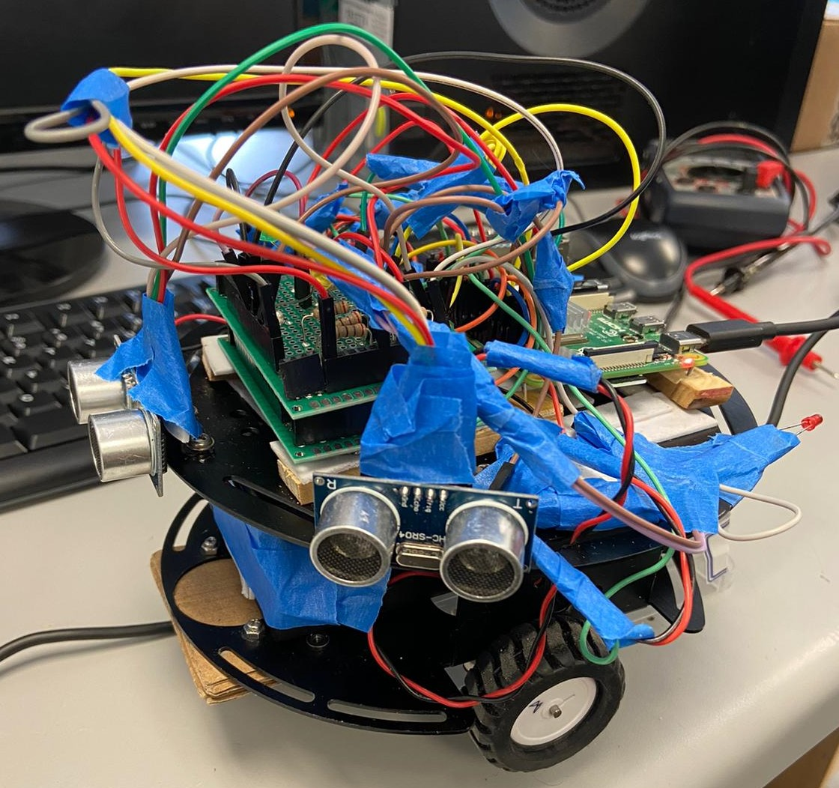
Smart Vehicle System -Team Green(Rohan, Bhargav, Tayeb)
Abstract:
In this project we are designing smart vehicle system in which,
Vehicle will detect obstacles and can avoids obstacle by changing its direction.
It will balance itself on the straight path with the help of encoder technology.
It will control its speed.
Conclusion:
By designing this we can avoid probable accident might happen worldwide.
System is easily implemented and cost efficient.
Problem:
While driving it happens often that any vehicle or obstacle come in way unexpectedly, which can cause life threatening accident.
So, we decided to Designed a system that can keeps driver and car both safe.
Future Scope:
In future we can add GPS technology along with computer vison.
Also, in addition vehicle will Maintain its speed depending on vehicle in front.
Hardware model:
Contact Information:
-Rohan Patel (linkedin.com/in/rohan4patel/)
-Bhargav Sakhiya (linkedin.com/in/bhargav-sakhiya/)
-Tayeb Zitouni (tzitouni5388@conestogac.on.ca)

